Slide 1
L13. Markov Decision Process
(Formulation)

Slide 2
L10. Markov Decision Process
(Formulation)
MDP definition
Cost (reward)
Transition probability

Slide 3
Introduction
Behavioral Game
Bayesian Game
Multi-agents
Reinforcement Learning
Model-free Optimization
Reinforcement Learning
Static Game/Bayesian Game
Dynamic Game
Multi Agents MDP/
Dec-POMDP
Data-driven
Single-Shot Decision Making
Multi agents
Multi stages
MDP
Dynamic Control
From now on,
we explore this direction!
Optimization/
Heuristic search
Sequential Decision Making in Under Uncertainties
Requires resonating about future sequences of actions and observations

Slide 4
Tension between breadth of applicability and mathematical tractability
Real worlds problems
Breadth of applicability
Mathematical tractability
Balance!

Slide 5

Introduction
Sequential Decision Making in Uncertainties
Many important problems require the decision maker to make a series of decisions.
It requires resonating about future sequences of actions and observations
No job
Researcher
Professor
Private company
Officer
House keeper
Action 1 : Get a job
Reward : 4,000$ per/mon
State:
Senior year
Action 2 : Go to graduate scale
State:
Action :
Publish X paper
Reward : 500$ per/mon
Action 3 : Start up company
Reward : 0$ per/mon
taking an action might lead to any one of many possible states
how we can even hope to act optimally in the face of randomness?

Slide 6

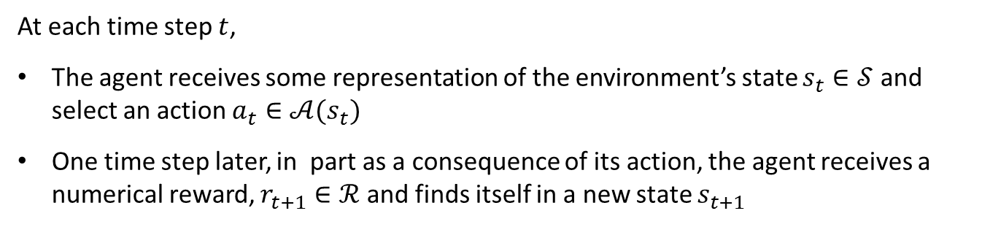




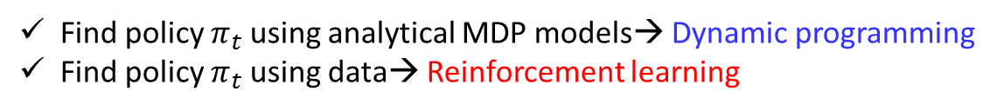
The Agent-Environment Interface
$$s_{t}$$
Agent
$$r_{t}$$
$$a_{t}$$
$$s_{t+1}$$
Environment
$$r_{t+1}$$
At each time step $t$,
The agent receives some representation of the environment’s state $s_{t}∈𝒮$ and select an action $a_{t}∈𝒜(s_{t})$
One time step later, in part as a consequence of its action, the agent receives a numerical reward, $r_{t+1}∈ℛ$ and finds itself in a new state $s_{t+1}$
The goal is to find the optimum policy ${a_{t}=π}_{t}(s_{t})$ mapping the current state $s_{t}$ to the optimum action $a_{t}^{∗}$ to maximize the total amount of reward it receives over the long run
Find policy $π_{t}$ using analytical MDP models→ Dynamic programming
Find policy $π_{t}$ using data→ Reinforcement learning
(next week)
(2 weeks later)

Slide 7
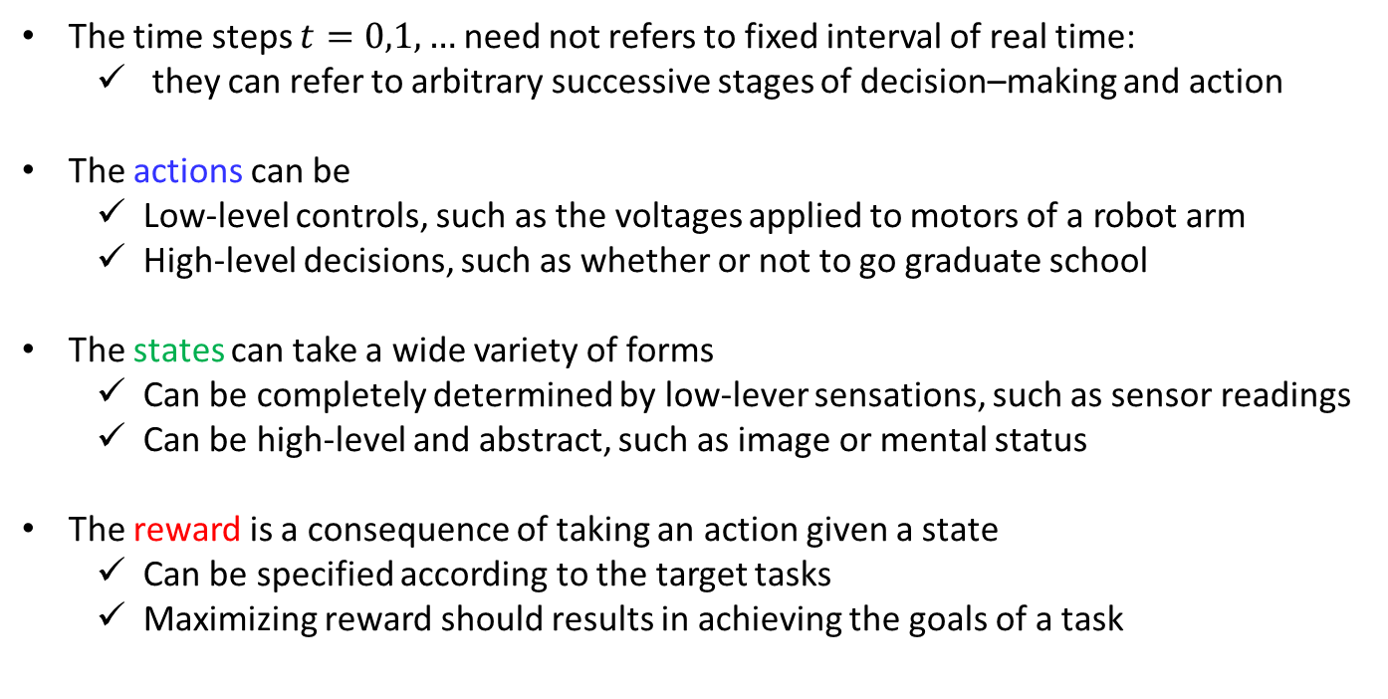
The Agent-Environment Interface
The time steps $t=0,1,…$ need not refers to fixed interval of real time:
they can refer to arbitrary successive stages of decision–making and action
The actions can be
Low-level controls, such as the voltages applied to motors of a robot arm
High-level decisions, such as whether or not to go graduate school
The states can take a wide variety of forms
Can be completely determined by low-lever sensations, such as sensor readings
Can be high-level and abstract, such as image or mental status
The reward is a consequence of taking an action given a state
Can be specified according to the target tasks
Maximizing reward should results in achieving the goals of a task
In summary,
Actions can be any decisions we want to learn how to make to affect rewards, and the states can be anything we can know that might be useful in making them

Slide 8
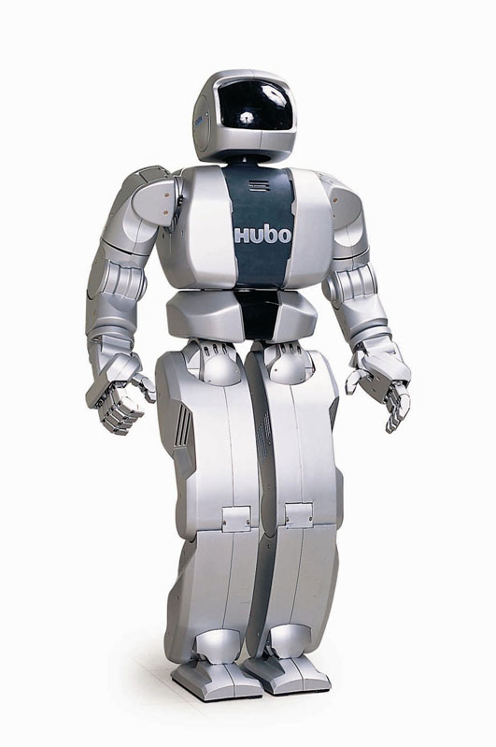
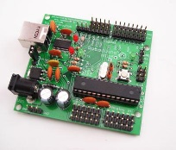
The Boundary between Agent-Environment
Agent :
Decision making algorithm
Environment:
Robot arm, motor, actuator, battery…
Anything that cannot be changed arbitrarily by the agent is considered to be outside of the agent and thus part of its environment
Reward computation should be outside of agent so that agent cannot arbitrarily change them
The agent-environment boundary represents the limit of the agent’s absolute control, not of its knowledge

Slide 9
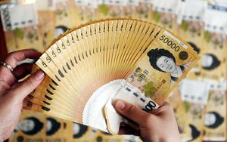














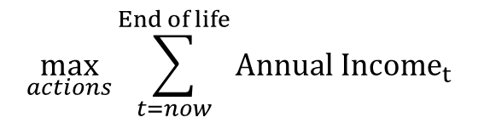

Goals and Rewards
Agent
Agent
Agent
Agent
…
Goals
$$a_{t}$$
$$r_{t}$$
$$a_{t+1}$$
$$r_{t+1}$$
$$a_{t+2}$$
$$r_{t+2}$$
$$a_{t+3}$$
$$r_{t+3}$$
Environment
$$s_{t}$$
Environment
$$s_{t+1}$$
Environment
$$s_{t+2}$$
Environment
$$s_{t+3}$$
…
The agent’s goal is to maximize the total amount of reward (cumulative reward) it receives.
Rewards we setup truly indicate what we want accomplished
The reward signal is your way of communicating to the agent what you want it to achieve, not how you want it achieved
$$\max_{a_{t},a_{t+1},…}{Σ_{k}r_{t+k}}$$
$$\max_{actions}{\sum_{t=now}^{End of life}{Annual {Income}_{t}}}$$
The goal of life:
Happy life
?
$$r_{t}$$

Slide 10
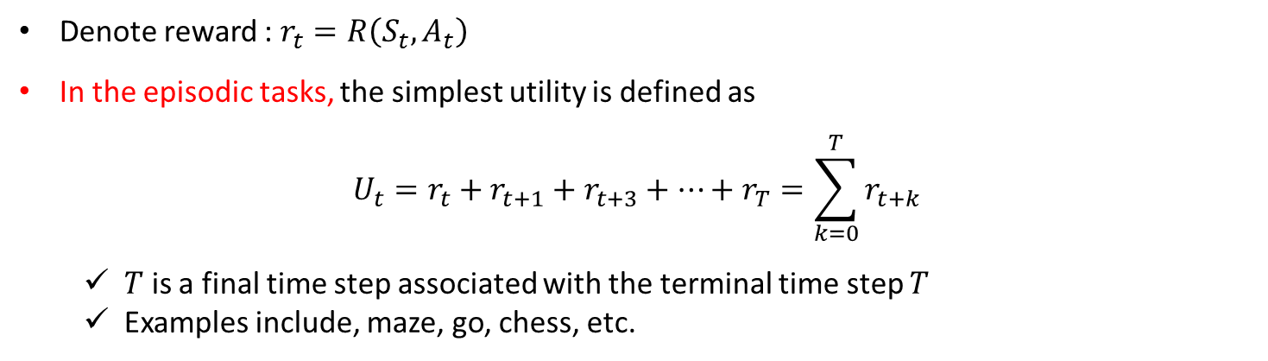
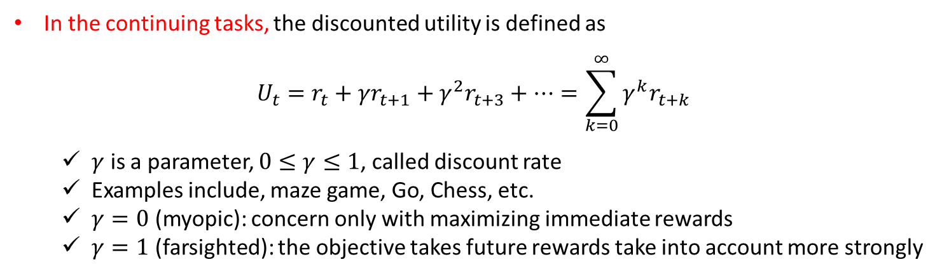
Utility (returns)
How to formally define the accumulated reward in the long run?
Denote reward : $r_{t}=R\left(S_{t},A_{t}\right)$
In the episodic tasks, the simplest utility is defined as
$$U_{t}=r_{t}+r_{t+1}+r_{t+3}+…+r_{T}=\sum_{k=0}^{T}{r_{t+k}}$$
$T$ is a final time step associated with the terminal time step $T$
Examples include, maze, go, chess, etc.
In the continuing tasks, the discounted utility is defined as
$$U_{t}=r_{t}+{γr}_{t+1}+{γ^{2}r}_{t+3}+…=\sum_{k=0}^{∞}{{γ_{ }^{k}r}_{t+k}}$$
$γ$ is a parameter, $0≤γ≤1$, called discount rate
Examples include, maze game, Go, Chess, etc.
$γ=0$ (myopic): concern only with maximizing immediate rewards
$γ=1$ (farsighted): the objective takes future rewards take into account more strongly

Slide 11

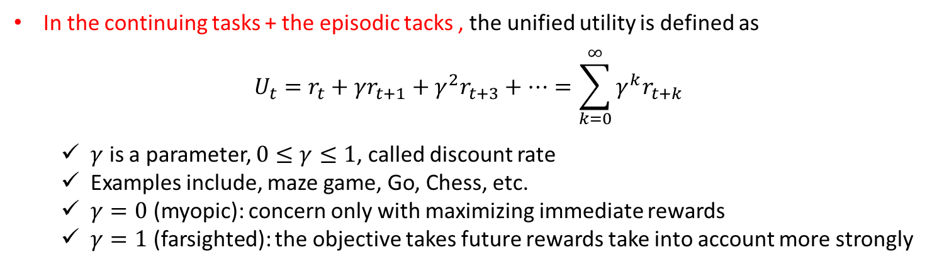







Utility (returns)
Assumptions:
1. Remove index for episode number
Episode 1
$\left(s_{1,1},a_{1,1},r_{1.1}\right),\left(s_{2,1},a_{2,1},r_{2.1}\right)$,…, $\left(s_{t,1},a_{t,1},r_{t.1}\right),…,\left(s_{T,1},a_{T,1},r_{T.1}\right)$
Episode 2
$\left(s_{1,2},a_{1,2},r_{1.2}\right),\left(s_{2,2},a_{2,2},r_{2.2}\right)$,…, $\left(s_{t,n},a_{t,n},r_{t.2}\right),…,\left(s_{T,1},a_{T,1},r_{T.2}\right)$
…
…
…
…
Episode $n$
$\left(s_{1,n},a_{1,n},r_{1.n}\right),\left(s_{2,n},a_{2,n},r_{2.n}\right)$,…, $\left(s_{t,n},a_{t,n},r_{t,n}\right),…,\left(s_{T,n},a_{T,n},r_{T.n}\right)$
$\left(s_{1},a_{1},r_{1}\right),\left(s_{2},a_{2},r_{2}\right)$,…, $\left(s_{t},a_{t},r_{t}\right),…,\left(s_{T},a_{T},r_{T}\right)$
2. Introduce the observing state, in which agent transits the same state with no reward
$${ r}_{1}=1$$
$${ r}_{2}=2$$
$${ r}_{3}=3$$
$${ s}_{0}$$
$${ s}_{1}$$
$${ s}_{2}$$
$${ s}_{2}$$
$${ r}_{4}=0,{ r}_{5}=0, { r}_{6}=0,…$$
In the continuing tasks + the episodic tacks , the unified utility is defined as
$$U_{t}=r_{t}+{γr}_{t+1}+{γ^{2}r}_{t+3}+…=\sum_{k=0}^{∞}{{γ_{ }^{k}r}_{t+k}}$$
$γ$ is a parameter, $0≤γ≤1$, called discount rate
Examples include, maze game, Go, Chess, etc.
$γ=0$ (myopic): concern only with maximizing immediate rewards
$γ=1$ (farsighted): the objective takes future rewards take into account more strongly

Slide 12
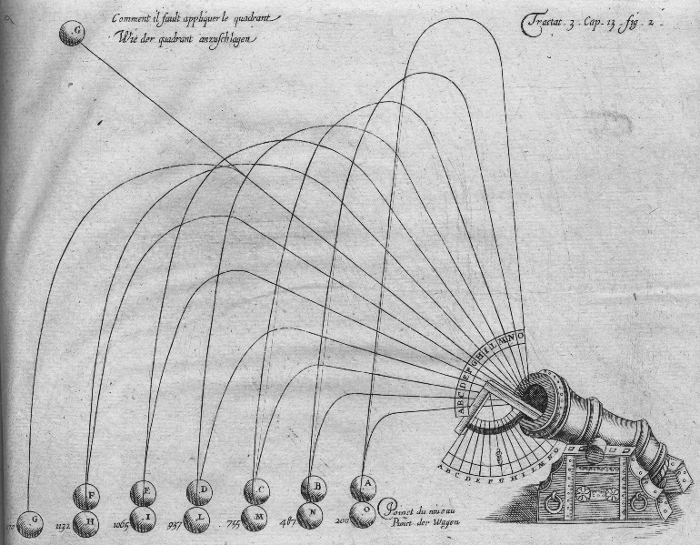
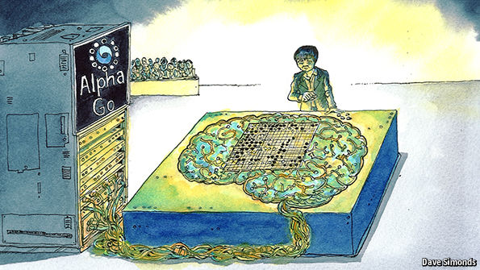


The Markov Property
The state is constructed and maintained on the basis of immediate sensations together with the previous state or some other memory of past sensations
Ideal state signal summarizes past sensations compactly, yet in such a way that all relevant information is retained
A state signal that succeeds in retaining all relevant information is said to be Markov
$$s_{t}=(x_{t},y_{t},v_{t})$$
$s_{t}=$ the location and velocity of the flying canon
$s_{t}=$ the configuration of the black and white stones

Slide 13
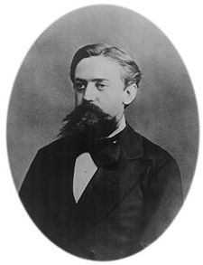
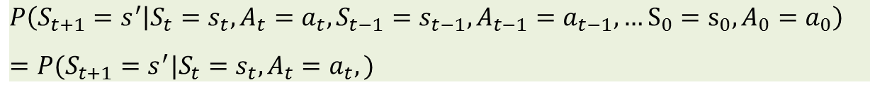

The Markov Property
“Markov” generally means that given the present state, the future and the past are intendent
Andrey Markov (1856-1922)
For Markov decision processes, “Markov” means action outcomes depend only on the current state
$$P\left(S_{t+1}=s^{′} | S_{t}=s_{t}, A_{t}=a_{t},S_{t−1}=s_{t−1}, A_{t−1}=a_{t−1},…S_{0}=s_{0},A_{0}=a_{0}\right)$$
$$=P(S_{t+1}=s^{′}|S_{t}=s_{t}, A_{t}=a_{t},)$$
The best policy for choosing actions as a function of a Markov state is just as good as the best policy for choosing actions as a function of complete history
$$π^{∗}\left(s_{t},s_{t−1}, …,s_{0}\right)=π^{∗}(s_{t})$$
Note:
As states become more Markovian, the better performance in MDP solution
It is useful to think of the state at each time step as an approximation to a Markov value

Slide 14
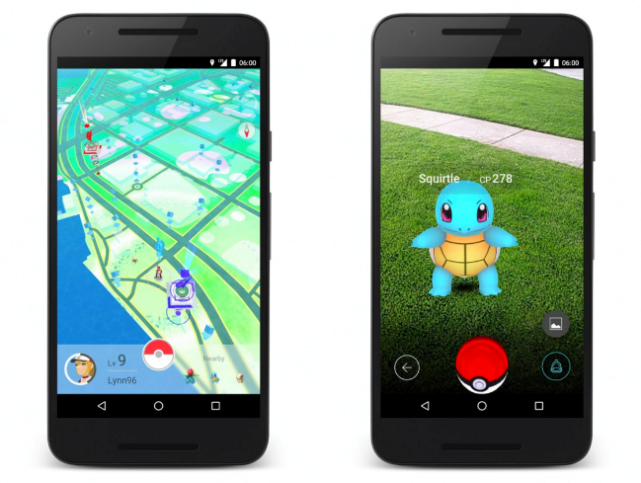

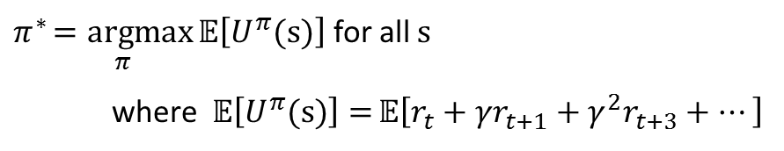




Policy
Policy
Reward
A policy $π$ gives an action $a∈𝒜$ for each state $s∈𝒮$:
$π:𝒮→𝒜$
An optimal policy $π^{∗}$ is one that maximizes expected utility if followed:
$π^{∗}\underset{π}{=argmax}{𝔼\left[U^{π}(s)\right]}$ for all $s$
where $𝔼\left[U^{π}(s)\right]={𝔼\left[r_{t}+{γr}_{t+1}+{γ^{2}r}_{t+3}+…\right]}$
An optimal policy can be either deterministic or stochastic
deterministic
Stochastic
$${a^{∗}=π}^{∗}(s)$$
$${p(a|s)=π}^{∗}(s,a)$$
Take action $a^{∗}$ with a probability one
Take action $a$ with a probability $p(a|s)$
We will exclusively consider deterministic policy

Slide 15
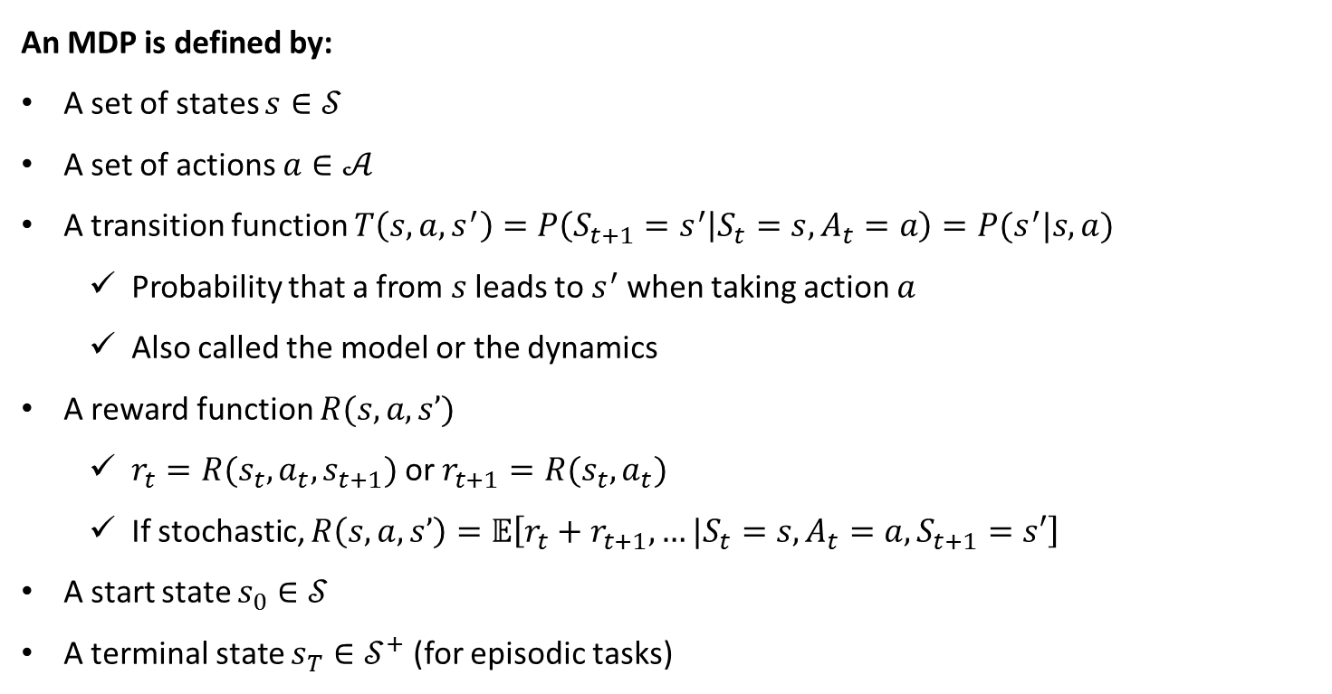
Markov Decision Processes
Finite Markov Decision Process (MDP) :The state and action space are finite
An MDP is defined by:
A set of states $s∈𝒮$
A set of actions $a∈𝒜$
A transition function $T\left(s,a,s^{′}\right)=P\left(S_{t+1}=s^{′} | S_{t}=s, A_{t}=a\right)=P(s^{′}|s,a)$
Probability that a from $s$ leads to $s^{′}$ when taking action $a$
Also called the model or the dynamics
A reward function $R(s, a, s’)$
$r_{t}=R(s_{t},a_{t},s_{t+1})$or $r_{t+1}=R(s_{t},a_{t})$
If stochastic, $R\left(s, a, s’\right)=𝔼\left[r_{t}+r_{t+1},…|S_{t}=s, A_{t}=a,S_{t+1}=s′\right]$
A start state $s_{0}∈𝒮$
A terminal state $s_{T}∈𝒮^{+}$(for episodic tasks)

Slide 16








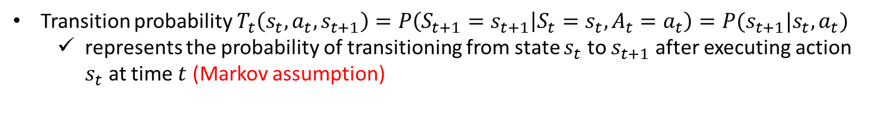




Markov Decision Processes
$$A_{t−1}$$
$$A_{t}$$
$$A_{t+1}$$
$A_{t}$ : action taken at time $t$
$$R_{t−1}$$
$$R_{t}$$
$$R_{t+1}$$
$R_{t}$ : reward received at time $t$
$$S_{t−1}$$
$$S_{t}$$
$$S_{t+1}$$
$S_{t}$ : state at time $t$
Transition probability $T_{t}\left(s_{t},a_{t},s_{t+1}\right)=P\left(S_{t+1}=s_{t+1} | S_{t}=s_{t}, A_{t}=a_{t}\right)=P(s_{t+1}|s_{t},a_{t})$
represents the probability of transitioning from state $s_{t}$ to $s_{t+1}$ after executing action $s_{t}$ at time $t$ (Markov assumption)
Reward function: $r_{t}=R_{t}(s_{t}, a_{t})$ : represents the probability of receiving reward $r_{t}$ when executing action $a_{t}$ from state $s_{t}$ at time $t$

Slide 17




(Stationary) Markov Decision Processes
$$A_{t}$$
$$R_{t}$$
$$S_{t}$$
$$S_{t+1}$$
Stationary Markov Decision Process (MDP)
→ transition and reward models are stationary
Transition probability $T\left(s_{t},a_{t},s_{t+1}\right)$ are the same for all time step $t$
Reward function: $r_{t}=R(s_{t}, a_{t})$ are the same for all time step $t$

Slide 18
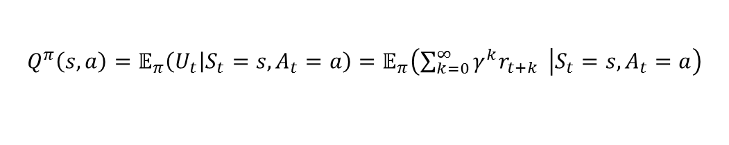

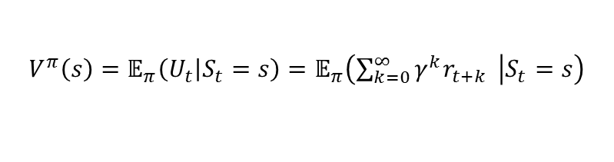

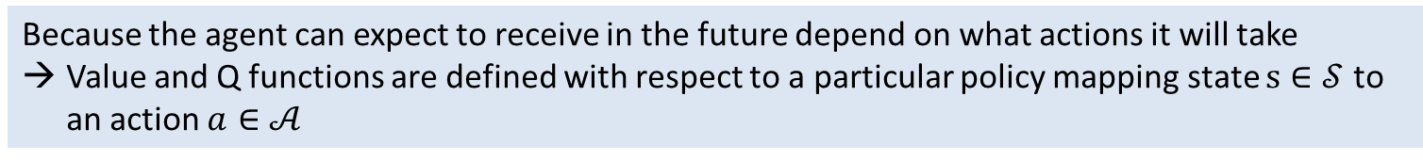
Value Function & Q function
Value function (state value function for $π$)
“How good it is for the agent to be in a given state”
$V^{π}\left(s\right)$ : The expected utility received by following policy $π$ from state $s$
$$V^{π}\left(s\right)=𝔼_{π}\left(U_{t} | S_{t}=s\right)=𝔼_{π}\left(\sum_{k=0}^{∞}{γ^{k}r_{t+k} } | S_{t}=s\right)$$
$𝔼_{π}$ : not expectation over policy $π$ but all stochastic state transitions associated with $π$
Q-function (action-value function for $π$)
“How good it is for the agent to perform a given action in a given state”
$Q^{π}\left(s, a\right)$ : The expected utility of taking action $a$ from state $s$, and then following policy $π$
$$Q^{π}\left(s,a\right)=𝔼_{π}\left(U_{t} | S_{t}=s,A_{t}=a\right)=𝔼_{π}\left(\sum_{k=0}^{∞}{γ^{k}r_{t+k} } | S_{t}=s,A_{t}=a\right)$$
Because the agent can expect to receive in the future depend on what actions it will take
Value and Q functions are defined with respect to a particular policy mapping state $s∈𝒮$ to an action $a∈𝒜$

Slide 19












































Value Function
All possible trajectories
$$S_{t}$$
$$A_{t}$$
$$S_{t+1}$$
$$A_{t+1}$$
$$S_{t+2}$$
$$T(s,a_{1},s_{1})$$
$$s_{1}$$
$$s,a_{1}$$
$$R\left(s,a_{1},s_{2}\right)$$
$$s_{1}$$
$$a_{1}$$
$$s_{2}$$
$$s_{1},a_{1}$$
$$T(s′,a_{2},s′′)$$
$$a_{1}$$
$$R\left(s′,a_{2},s′′ \right)$$
$$s_{2}$$
$$s_{1}$$
$$a_{2}$$
$$s_{1},a_{2}$$
$$s$$
$$a_{2}$$
$$s,a_{2}$$
$$a_{3}$$
$$T(s,a_{2},s_{2})$$
$$s_{1},a_{3}$$
$$R\left(s,a_{2},s_{2}\right)$$
$$s_{2}$$
$$a_{3}$$
$$a_{1}$$
$$a_{2}$$
$$s_{2},a_{1}$$
$$s_{1}$$
$$a_{3}$$
$$s,a_{3}$$
$$s_{1}$$
$$s_{2},a_{2}$$
$$s_{2}$$
$$s_{2}$$
$$s_{2},a_{3}$$

Slide 20



























Value Function
A policy $π$ is given as: $π\left(s\right)=a_{2}; π\left(s_{1}\right)=a_{1}; π\left(s_{2}\right)=a_{2}$
$$S_{t}$$
$$A_{t}$$
$$S_{t+1}$$
$$A_{t+1}$$
$$S_{t+2}$$
$$T(s,a_{1},s_{1})$$
$$s_{1}$$
$$s,a_{1}$$
$$R\left(s,a_{1},s_{1} \right)$$
$$s_{1}$$
$$a_{1}$$
$$s_{2}$$
$$s_{1},a_{1}$$
$$T(s′,a_{2},s_{1})$$
$$a_{1}$$
$$R\left(s′,a_{2},s_{2} \right)$$
$$s_{2}$$
$$s_{1}$$
$$a_{2}$$
$$s_{1},a_{2}$$
$$s$$
$$a_{2}$$
$$s,a_{2}$$
$$a_{3}$$
$$T(s,a_{2},s_{2})$$
$$s_{1},a_{3}$$
$$R\left(s,a_{2},s_{2} \right)$$
$$s_{2}$$
$$a_{3}$$
$$a_{1}$$
$$a_{2}$$
$$s_{2},a_{1}$$
$$s_{1}$$
$$a_{3}$$
$$s,a_{3}$$
$$s_{1}$$
$$s_{2},a_{2}$$
$$s_{2}$$
$$s_{2}$$
$$s_{2},a_{3}$$

Slide 21


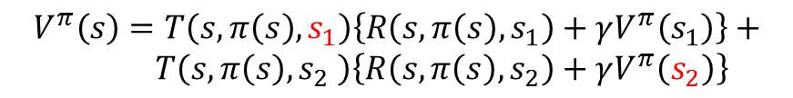









Value Function
A policy $π$ is given as: $π\left(s\right)=a_{2}; π\left(s_{1}\right)=a_{1}; π\left(s_{2}\right)=a_{2}$
$$S_{t}$$
$$A_{t}$$
$$S_{t+1}$$
$$A_{t+1}$$
$$S_{t+2}$$
$$V^{π}(s^{′}=s_{1})$$
$$V^{π}(s)$$
$$T(s,π(s),s_{1})$$
$$R\left(s,π(s),s_{1} \right)$$
$$s_{1}$$
$$s$$
$$a_{2}=π(s)$$
$$s,a_{2}$$
$$T(s,π(s),s_{2})$$
$$s_{2}$$
$$R\left(s,π(s),s_{2} \right)$$
$$V^{π}(s^{′}=s_{2})$$
$$V^{π}\left(s\right)=T\left(s,π\left(s\right),s_{1}\right)\left\{R\left(s,π\left(s\right),s_{1}\right)+γV^{π}\left(s_{1}\right)\right\}+$$
$T\left(s,π\left(s\right),s_{2} \right)\left\{R\left(s,π\left(s\right),s_{2}\right)+γV^{π}\left(s_{2}\right)\right\}$

Slide 22
















The Bellman Equation for Value Function
Recursive Formulation (The Bellman equation)
$$V^{π}\left(s\right)$$
$$=𝔼_{π}\left(\sum_{k=0}^{∞}{γ^{k}r_{t+k} } | S_{t}=s\right)$$
$${=𝔼}_{π}\left(r_{t}+γ\sum_{k=0}^{∞}{γ^{k}r_{t+1+k} } | S_{t}=s\right)$$
$$=\sum_{s′}{T(s,π(s),s^{′})\left\{R\left(s,π(s),s^{′}\right)+γ𝔼_{π}\left(\sum_{k=0}^{∞}{γ^{k}r_{t+1+k} } | S_{t+1}=s′\right)\right\}}$$
$$=\sum_{s′}{T(s,π(s),s^{′})\left\{R\left(s,π(s),s^{′}\right)+γV^{π}\left(s′\right)\right\}}$$
The value of the start state must equal the (discounted) value of the expected next state, plus the reward expected along the way
$$V^{π}(s^{′}=s_{1})$$
$$V^{π}(s)$$
$$T(s,a_{2},s_{1})$$
$$R\left(s,a_{2},s_{1}\right)$$
$$s_{1}$$
$$s$$
$$a_{2}=π(s)$$
$$s,a_{2}$$
$$T(s,a_{2},s_{2})$$
$$s_{2}$$
$$R\left(s,a_{2},s_{2} \right)$$
$$V^{π}(s^{′}=s_{2})$$
state node
chance node
$$T(s,π\left(s\right),s′)$$

Slide 23
























Q function
All possible trajectories
$$S_{t}$$
$$A_{t}$$
$$S_{t+1}$$
$$A_{t+1}$$
$$S_{t+2}$$
$$T(s,a_{1},s_{1})$$
$$s_{1}$$
$$s,a_{1}$$
$$R\left(s,a_{1},s_{2}\right)$$
$$s_{1}$$
$$a_{1}$$
$$s_{2}$$
$$s_{1},a_{1}$$
$$T(s′,a_{2},s′′)$$
$$a_{1}$$
$$R\left(s′,a_{2},s′′ \right)$$
$$s_{2}$$
$$s_{1}$$
$$a_{2}$$
$$s_{1},a_{2}$$
$$s$$
$$a_{2}$$
$$s,a_{2}$$
$$a_{3}$$
$$T(s,a_{2},s_{2})$$
$$s_{1},a_{3}$$
$$R\left(s,a_{2},s_{2}\right)$$
$$s_{2}$$
$$a_{3}$$
$$a_{1}$$
$$a_{2}$$
$$s_{2},a_{1}$$
$$s_{1}$$
$$a_{3}$$
$$s,a_{3}$$
$$s_{1}$$
$$s_{2},a_{2}$$
$$s_{2}$$
$$s_{2}$$
$$s_{2},a_{3}$$

Slide 24













Q function
A policy $π$ is given as: $π\left(s\right)=a_{2}; π\left(s_{1}\right)=a_{1}; π\left(s_{2}\right)=a_{2}$
$$S_{t}$$
$$A_{t}$$
$$S_{t+1}$$
$$A_{t+1}$$
$$S_{t+2}$$
$$T(s,a_{1},s_{1})$$
$$s_{1}$$
$$s,a_{1}$$
$$R\left(s,a_{1},s_{1} \right)$$
$$s_{1}$$
$$a_{1}$$
$$s_{2}$$
$$s_{1},a_{1}$$
$$T(s′,a_{2},s_{1})$$
$$a_{1}$$
$$R\left(s′,a_{2},s_{2} \right)$$
$$s_{2}$$
$$s_{1}$$
$$a_{2}$$
$$s_{1},a_{2}$$
$$s$$
$$a_{2}$$
$$s,a_{2}$$
$$a_{3}$$
$$T(s,a_{2},s_{2})$$
$$s_{1},a_{3}$$
$$R\left(s,a_{2},s_{2} \right)$$
$$s_{2}$$
$$a_{3}$$
$$a_{1}$$
$$a_{2}$$
$$s_{2},a_{1}$$
$$s_{1}$$
$$a_{3}$$
$$s,a_{3}$$
$$s_{1}$$
$$s_{2},a_{2}$$
$$s_{2}$$
$$s_{2}$$
$$s_{2},a_{3}$$

Slide 25






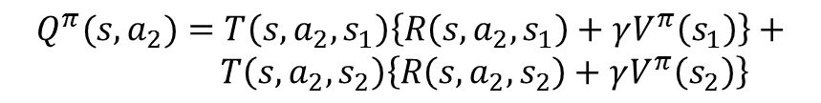



Q Function
A policy $π$ is given as: $π\left(s\right)=a_{2}; π\left(s′\right)=a_{1}; π\left(s′′\right)=a_{2}$
$$S_{t}$$
$$A_{t}$$
$$S_{t+1}$$
$$A_{t+1}$$
$$S_{t+2}$$
$$V^{π}({s^{′}=s}_{1})$$
$$Q^{π}(s,a_{2})$$
$$T(s,a_{2},s_{1})$$
$$R\left(s,a_{2},s_{1} \right)$$
$$s_{1}$$
$$s$$
$$a_{2}$$
$$s,a_{2}$$
$$T(s,a_{2},s_{2})$$
$$s_{2}$$
$$R\left(s,a_{2},s_{2} \right)$$
$$V^{π}({s^{′}=s}_{2})$$
$$Q^{π}(s,a_{2})=T\left(s,a_{2},s_{1}\right)\left\{R\left(s,a_{2},s_{1}\right)+γV^{π}\left(s_{1}\right)\right\}+$$
$T\left(s,a_{2},s_{2}\right)\left\{R\left(s,a_{2},s_{2}\right)+γV^{π}\left(s_{2}\right)\right\}$

Slide 26


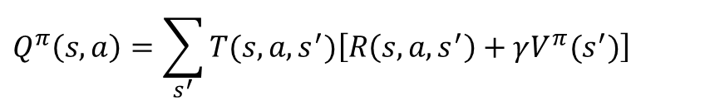












Q Function
$$Q^{π}(s,a)$$
$$V^{π}(s^{′}=s_{1})$$
$$V^{π}(s)$$
$$T(s,a,s_{1})$$
$$R\left(s,a,s_{1} \right)$$
$$s_{1}$$
$$s$$
$$a=π(s)$$
$$s,a$$
$$T(s,a, s_{2})$$
$$s_{2}$$
$$R\left(s,a,s_{2} \right)$$
$$V^{π}(s^{′}=s_{2})$$
$$Q_{ }^{π}\left(s,a\right)=\sum_{s^{′}}{T(s,a,s^{′})\left[R\left(s,a,s^{′}\right)+γV^{π}(s^{′})\right]}$$
Note that:
$$V^{π}\left(s\right)=\sum_{s′}{T\left(s,π\left(s\right),s^{′}\right)\left\{R\left(s,π\left(s\right),s^{′}\right)+γV^{π}\left(s^{′}\right)\right\}}$$
$$=Q_{ }^{π}\left(s,π(s)\right)$$
$Q_{ }^{π}\left(s,a\right)$ is more general since it has the option to select an action $a$ given state $s$
If the action is enforced to select $a=π\left(s\right)$ according to the policy $π$, $V^{π}\left(s\right)=Q_{ }^{π}\left(s,π(s)\right)$

Slide 27



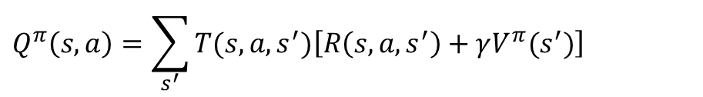












Summary for Value function and Q function
$$Q^{π}(s,a)$$
$$V^{π}(s^{′}=s_{1})$$
$$V^{π}(s)$$
$$T(s,a,s_{1})$$
$$R\left(s,a,s_{1} \right)$$
$$s_{1}$$
$$s$$
$$a=π(s)$$
$$s,a$$
$$T(s,a, s_{2})$$
$$s_{2}$$
$$R\left(s,a,s_{2} \right)$$
$$V^{π}(s^{′}=s_{2})$$
$$V^{π}\left(s\right)=\sum_{s′}{T(s,π(s),s^{′})\left\{R\left(s,π(s),s^{′}\right)+γV^{π}\left(s′\right)\right\}}$$
$$Q_{ }^{π}\left(s,a\right)=\sum_{s^{′}}{T(s,a,s^{′})\left[R\left(s,a,s^{′}\right)+γV^{π}(s^{′})\right]}$$
$$V^{π}\left(s\right)=Q_{ }^{π}\left(s,π(s)\right)$$

Slide 28



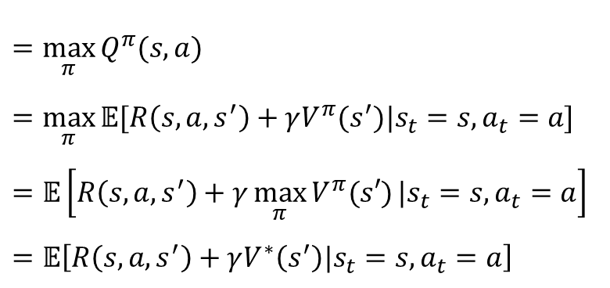

Optimal Value Function & Q function
$π′≥π$ if and only if $V^{π′}\left(s\right)≥V^{π}(s)$ for all $s$
Optimal state- value function
$V^{∗}\left(s\right)=\max_{π}{V^{π}(s)}$ for all $s$
Optimal action-value function
$Q^{∗}\left(s,a\right)=\max_{π}{Q^{π}(s,a)}$ for all $s∈𝒮$ and $a∈𝒜(s)$
$$Q^{∗}\left(s,a\right)$$
$$=\max_{π}{Q^{π}(s,a)}$$
$$=\max_{π}{𝔼[R\left(s,a,s^{′}\right)+γV^{π}(s^{′})\text{|}s_{t}=s, a_{t}=a\text{]}}$$
$$=𝔼\left[R\left(s,a,s^{′}\right)+γ\max_{π}{V^{π}(s′)}|s_{t}=s, a_{t}=a\right]$$
$$=𝔼\left[R\left(s,a,s^{′}\right)+γV^{∗}\left(s^{′}\right)|s_{t}=s, a_{t}=a\right]$$
$∵Q_{ }^{π}\left(s,a\right)=𝔼[R\left(s,a,s^{′}\right)+γV^{π}(s^{′})|s_{t}=s, a_{t}=a$]
$𝔼$ is over the next state $s^{′}$

Slide 29























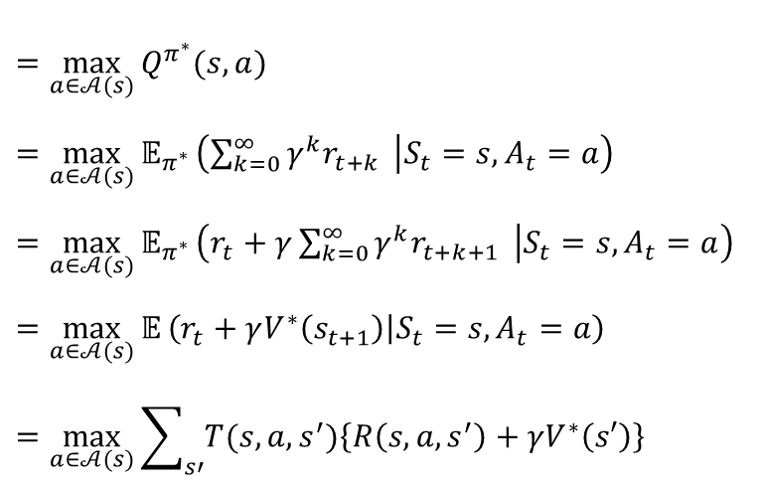

Bellman Optimality Equation for State-Value Function
Bellman optimality equation for $V^{∗}(s)$
$$Q^{π^{∗}}(s,a_{1})$$
$$s_{1}$$
$$V^{∗}(s^{′}=s_{1})$$
$$s,a_{1}$$
$$a_{1}$$
$$s_{2}$$
$$V^{∗}(s^{′}=s_{1})$$
$$Q^{π^{∗}}(s,a_{2})$$
$$s_{1}$$
$$s$$
max
$$a_{2}$$
$$s,a_{2}$$
$$V^{∗}(s)$$
$$s_{2}$$
$$a_{3}$$
$$Q^{π^{∗}}(s,a_{3})$$
$$s_{1}$$
$$s,a_{3}$$
$$=\max_{a∈𝒜(s)}{Q^{π^{∗}}(s,a)}$$
$$=\max_{a∈𝒜(s)}{𝔼_{π^{∗}}}\left(\sum_{k=0}^{∞}{γ^{k}r_{t+k} } | S_{t}=s, A_{t}=a\right)$$
$$=\max_{a∈𝒜(s)}{𝔼_{π^{∗}}}\left(r_{t}+γ\sum_{k=0}^{∞}{γ^{k}r_{t+k+1} } | S_{t}=s, A_{t}=a\right)$$
$$=\max_{a∈𝒜(s)}{𝔼}\left(r_{t}+γV^{∗}\left(s_{t+1}\right) | S_{t}=s, A_{t}=a\right)$$
$$=\max_{a∈𝒜(s)}{\sum_{s′}{T(s,a,s^{′})\left\{R\left(s,a,s^{′}\right)+γV^{∗}\left(s′\right)\right\}}}$$
$$V^{∗}\left(s\right)$$
$$s_{2}$$
$𝔼$ is over transitions associated with $π^{∗}$
$𝔼$ is over transitions
First take optimum action and follow the optimum policy

Slide 30


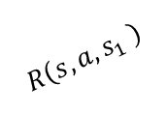


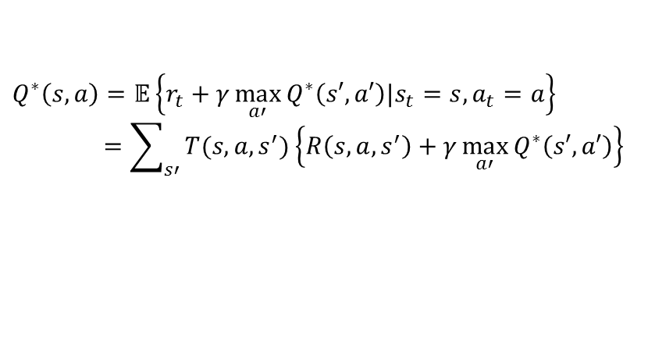


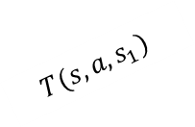


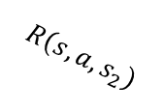








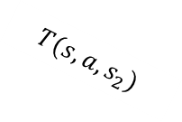





Bellman Optimality Equation for State-Action Value Function
Bellman optimality equation for $Q^{∗}(s,a)$
$$S^{′}$$
$$A^{′}$$
$$a_{1}$$
$$s_{1},a′$$
$$Q^{∗}\left(s_{1},a′\right)$$
$$s_{1}$$
max
$$T(s,a,s_{1})$$
$$a_{2}$$
$$s_{1},a′′$$
$$R\left(s,a,s_{1} \right)$$
$$Q^{∗}\left(s_{2},a′′\right)$$
$$Q^{∗}(s,a)$$
$$s,a$$
$$T(s,a,s_{2})$$
$$a_{1}$$
$$s_{2},a′$$
$$Q^{∗}\left(s_{1},a′\right)$$
$$R\left(s,a,s_{2}\right)$$
$$s_{2}$$
max
$$a_{2}$$
$$s_{2},a′′$$
$$Q^{∗}\left(s_{2},a′′\right)$$
$$Q^{∗}\left(s,a\right)=𝔼\left\{r_{t}+γ\max_{a′}{Q^{∗}\left(s′,a′\right)|s_{t}=s, a_{t}=a}\right\}$$
$$=\sum_{s′}{T(s,a,s^{′})\left\{R\left(s,a,s^{′}\right)+γ\max_{a′}{Q^{∗}\left(s′,a′\right)}\right\}}$$
$𝔼$ is over transitions $s^{′}→s^{′}$
First transits by transition probability and take the optimum action for each consequent states

Slide 31







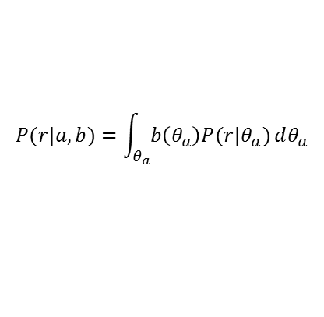


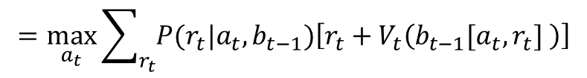

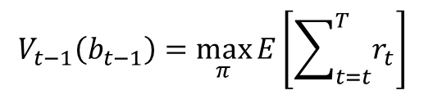
Reinforcement Learning Approach
MDP over belief state and finding optimal policy using Dynamic Programming
$h_{t}=\left[\left(a_{1},r_{1}\right), \left(a_{1},r_{1}\right),…, \left(a_{t},r_{t}\right)\right]$
$$A_{t−1}$$
$$A_{t}$$
$θ=\left(θ_{i},…,θ_{n}\right)$ : Unknown machine parameters
Belief state $b_{t}\left(θ\right)=$ $P\left(θ|h_{t}\right)$ : probability dist. on para.
$$R_{t−1}$$
$$R_{t}$$
Updating belief state $b_{t}\left(θ\right)$ for Binary bandit
with prior $Beta\left(θ_{i}|α,β\right)$ : Deterministic
$$b_{t}\left(θ_{i}\right)=b_{t−1}\left[a_{t},r_{t}\right]=Beta\left(θ_{i}|α+w_{t,i},β+l_{t,i}\right)$$
$$b_{t−1}$$
$$b_{t}$$
$w_{t,i}$: Accumulated wins with arm $i$ up to time $t$
$l_{t,i}$: Accumulated loses with arm $i$ up to time $t$
Dynamic programming on the value function
$$V_{t−1}\left(b_{t−1}\right)=\max_{π}{E\left[\sum_{t=t}^{T}{r_{t}}\right]}$$
$$=\max_{a_{t}}{\sum_{r_{t}}{P(r_{t}|a_{t},b_{t−1})\left[r_{t}+V_{t}\left(b_{t−1}[a_{t},r_{t}] \right)\right]}}$$
$$P(r|a,b)=\int_{θ_{a}}^{ }{b\left(θ_{a}\right)P(r|θ_{a})}dθ_{a}$$

Slide 32
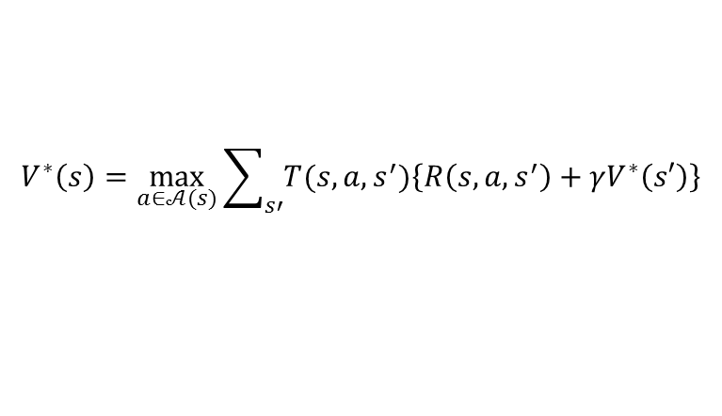
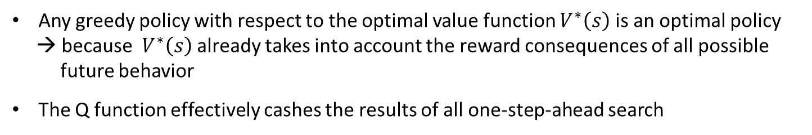
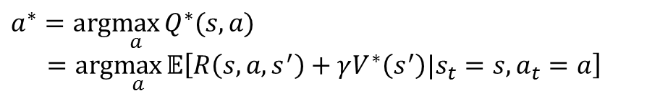
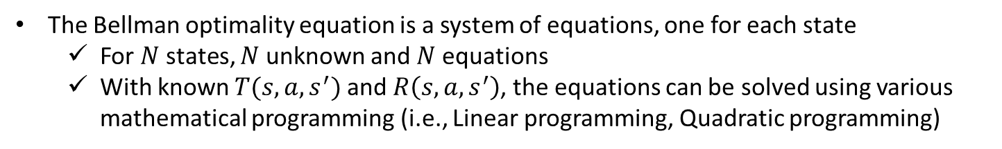
Optimum Planning as a Greedy Search
$$V^{∗}\left(s\right)=\max_{a∈𝒜(s)}{\sum_{s′}{T(s,a,s^{′})\left\{R\left(s,a,s^{′}\right)+γV^{∗}\left(s′\right)\right\}}}$$
The Bellman optimality equation is a system of equations, one for each state
For $N$ states, $N$ unknown and $N$ equations
With known $T(s,a,s^{′})$ and $R\left(s,a,s^{′}\right)$, the equations can be solved using various mathematical programming (i.e., Linear programming, Quadratic programming)
Reconstructing optimal policy with $Q^{∗}(s,a)$ and $V^{∗}(s)$
$$a^{∗}=arg\max_{a}{Q^{∗}(s,a)}$$
$$=arg\max_{a}{𝔼\left[R\left(s,a,s^{′}\right)+γV^{∗}\left(s^{′}\right)|s_{t}=s, a_{t}=a\right]}$$
Any greedy policy with respect to the optimal value function $V^{∗}\left(s\right)$ is an optimal policy
→ because $V^{∗}\left(s\right)$ already takes into account the reward consequences of all possible
future behavior
The Q function effectively cashes the results of all one-step-ahead search

Slide 33
Road Map for Next Lectures
Parametric representation
ADP
Supervised learning
RL
No model
Local learning :
Learn only around we are interested
Approximate solution
Model based
MDP
DP
Exact solution
Usually Tabular representation
For special case, DP can be used for solving a MDP with continuous space and action
All other methods can be viewed as attempts to achieve much the same effect as DP, only with less computation and without assuming a perfect model of the environment

Slide 34
Midterm statistics
Under
Mean: 68.81
std: 13.94
Median: 71
Grad
Mean: 79.14
std: 6.99
Median: 80
Total:
Mean: 72.48
std: 12.87
Median: 74.75
Max: 88
Claims :
Problem 1:5 : 정요한 : becre1776@kaist.ac.kr
Problem 6:7: 박준영 : joon0105@kaist.ac.kr
Problem 8:10: 이한선: Joanna@kaist.ac.kr

